Slide 1
PERMISSIONED BLOCKCHAINS
- PRIYABRATA PATI

Slide 2
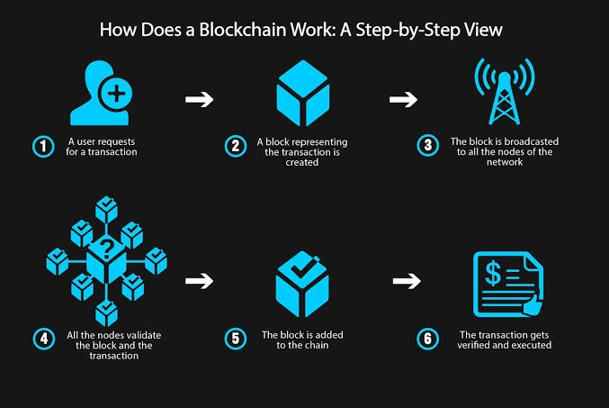

Slide 3
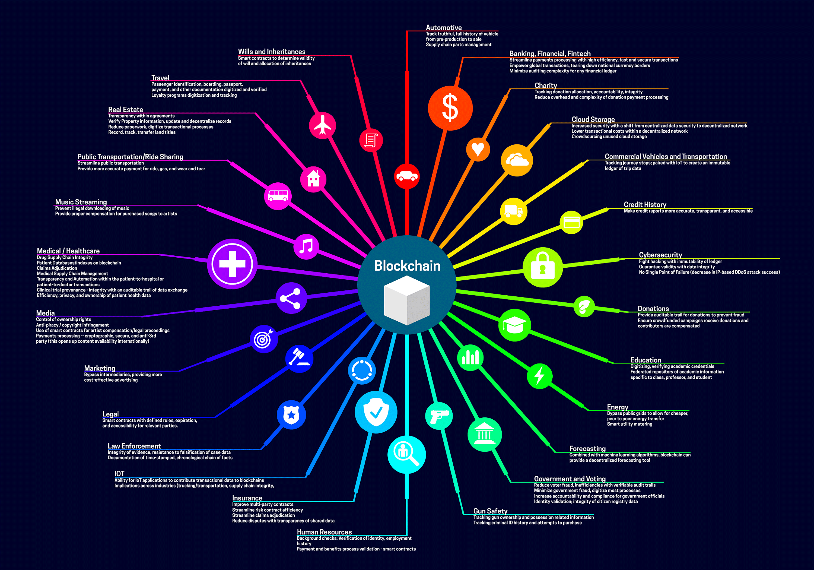

Slide 4
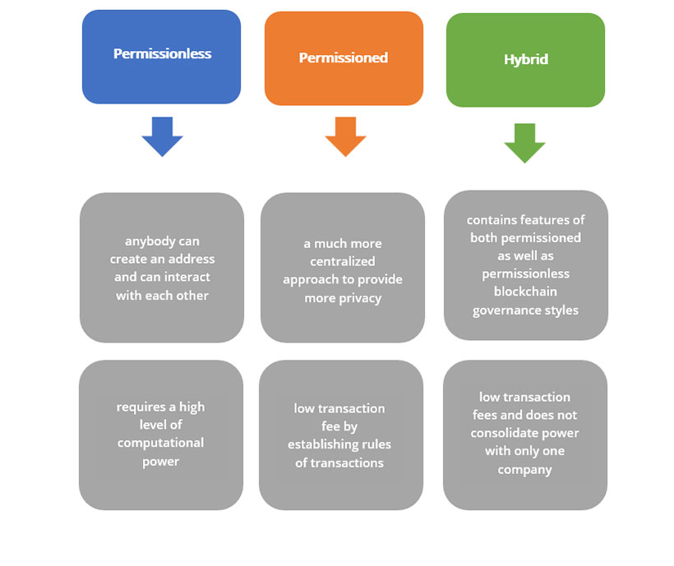

Slide 5
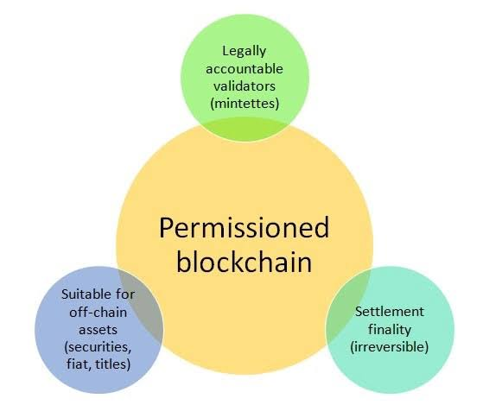

Slide 6
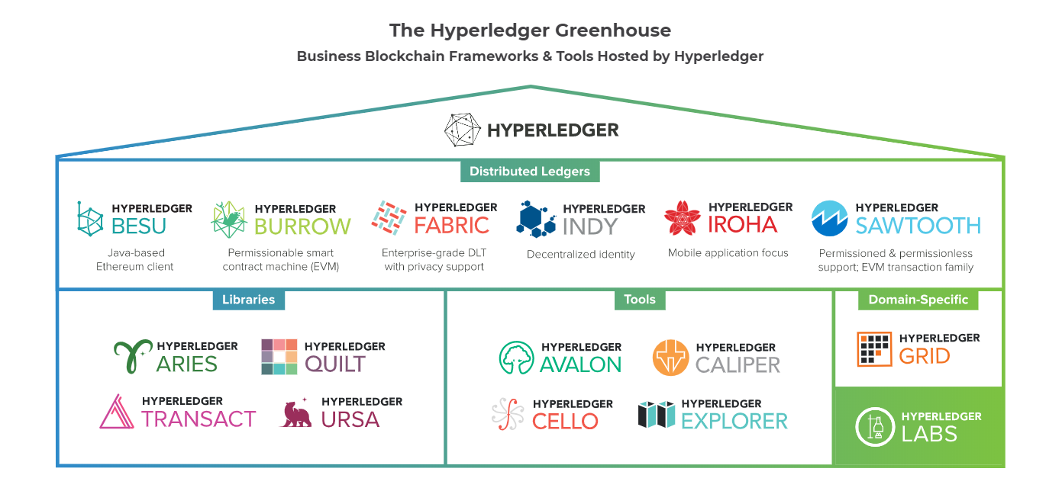

Slide 7


WHY FABRIC ?

Slide 8

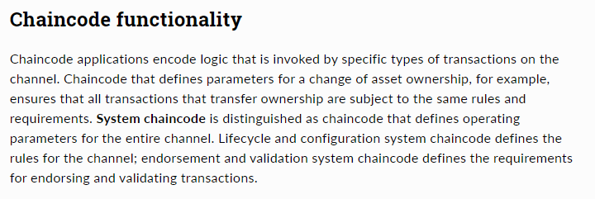


Slide 9
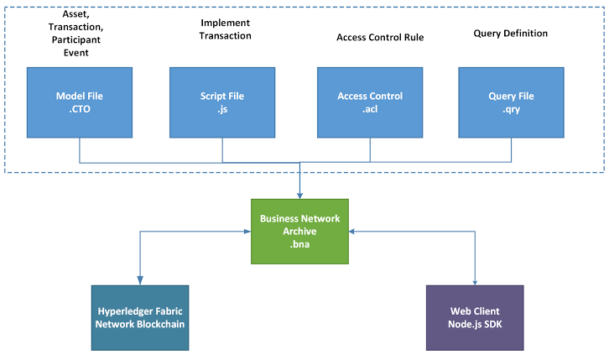
HYPERLEDGER COMPOSER

Slide 10
THANK YOU !

